Slide 1
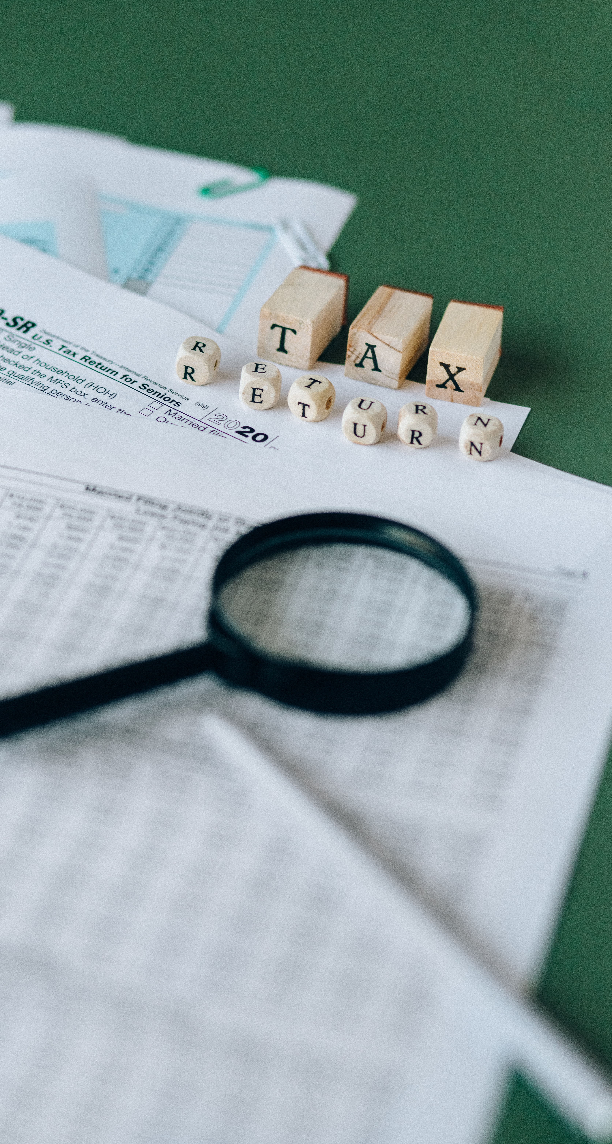
Mini thesis
Automation in Taxation System to Avoid Tax Evasion by Sole Proprietors: Finnish Tax System
Presented by: Group 11
Imran Irshad, Hafiz Javid
Dated: March 10th, 2023

Slide 2
Thesis Outline
Chapter 1.
Introduction: Summary of the thesis
1
Chapter 2.
Literature Review:
Tax Evasion
Automated Solutions
2
Chapter 3.
Methods and techniques:
Systemic Literature Review
3
Chapter 4.
Results:
Robotics Process Automation (RPA)
Examples of different countries
4
Chapter 5.
Conclusion:
Automation can be the best solution
5

Slide 3
Introduction
Following have been discussion
Background of the study:
A social welfare state
Tax grey areas
Problem related to tax evasion
Sole proprietors and tax evasion
Problem statement:
Tax evasion techniques
Solution:
Automation as a most effective solution

Slide 4
Literature Review
Tax Evasion Techniques :
hiding cash transactions
Showing more expenses than actual
Show more depreciation on assets
Manipulating with employee fund
Automation :
Robotic automation system
Software solution
Coding system

Slide 5
Methods
Research Literature Review
News Reports Review
Cross countries analysis
(Norway, Sweden, and USA)

Slide 6
Results
Use of RPA as an effective tool
Norway: digitalization of VAT reporting
Sweden: risk evaluation of business registration by automated system
USA: Inland revenue use UI path for finance and procurement responsibilities
Finnish Tax Authorities take advantage from automation technology and improve the system

Slide 7

Conclusion
Finnish tax collection can be improved
Benefit to overall economy
Steps for future research
Interviews can be done
A prototype system can be developed

Slide 8

THANK YOU!
Questions & Comments

